Slide 1

DS 501
Case Study No.2
Group 10
Jiexuan Sun,
Chao Xu,
Zhaoning Su,
Congyang Wang
Notes:
Hello everyone, Hello professor Paffenroth, this is the second time we come here to share with you our found, ok, let’s start with this cover, there are 448 movie posters on screen, they are not the random, they are the movie I watched and rated in past 10 years. We do this for a little long time just want to make you guys love watching these slides.
*: I am a honest man, so I even use this poster twice to make this this happened.
You know, for some reason, it’s more easier to watch the movies around the world Hollywood, Bollywood and so on.

Slide 2
content of table
zero
content of table
The motivation about the data
How did we analyze the data
What did we find and conjecture in the data
Surprising data

Slide 3
one
The motivation about the data
Motivation

Slide 4







one
The motivation about the data
No.1
No.2
No.3
No.4
We are four data scientists from 21th Century Dogs
We love movie
We love data
We need to report to our BOSS

Slide 5
two
How did we analyze the data
How to do with it
Notes:
We store the h5 data

Slide 6




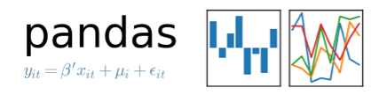
two
How did we analyze the data
Movies
Ratings
Database.h5
Users
Notes:
We store the h5 data

Slide 7
three
What did we find and conjecture in the data
Some tests
Notes:
We made several basic test to the data…… we know you guys did the same test, so I will make this part fast.

Slide 8



three
What did we find and conjecture in the data
#Compute how many movies have an average rating over 4.5 overall.
21
#Compute how many movies have an average rating over 4.5 overall among men and women.
M:23 F:51
#Compute how many movies have an median rating over 4.5 overall among men and women over age 30.
M:86 F:149
#Find the movie with most number of ratings.
Notes:
We made several basic test to the data…… we know you guys did the same test, so I will make this part fast.

Slide 9
three
What did we find and conjecture in the data
#1. We conjecture that people who occupation is "10:K-12 student" are the easiest to please.
#Compute the ratings mean and standard deviation of grouped by occupations

Slide 10
three
What did we find and conjecture in the data
#2. We conjecture that Female are the easiest to please.
#Compute the ratings mean and standard deviation of grouped by gender

Slide 11
three
What did we find and conjecture in the data
#3. We conjecture users who age belong to "50:50-55" are the easiest to please.
#Compute the ratings mean and standard deviation of grouped by age

Slide 12
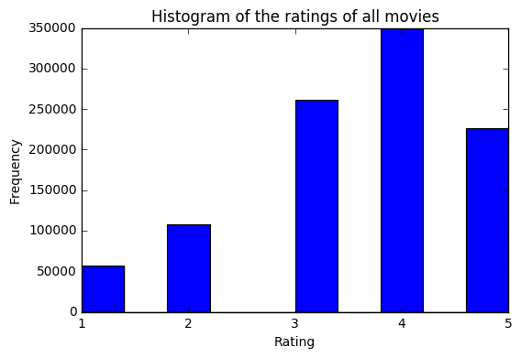
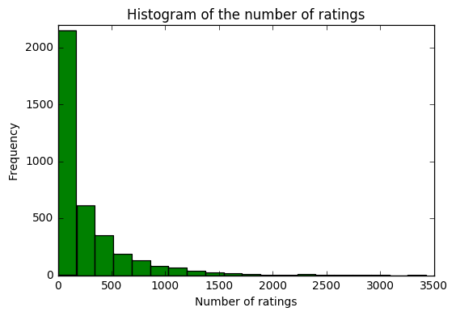
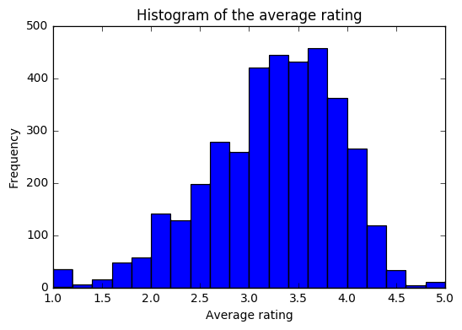
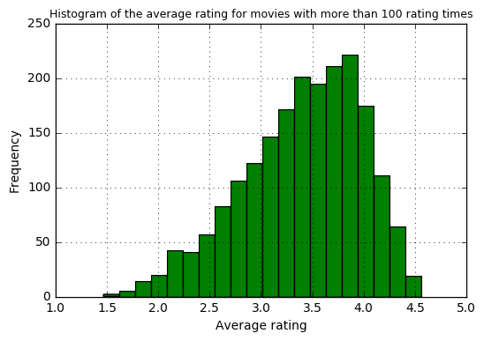
three
What did we find and conjecture in the data
#Plot a histogram of the ratings of all movies.
#Plot a histogram of the number of ratings each movie received.
#Plot a histogram of the average rating for each movie.
Plot a histogram of the average rating for movies which are rated more than 100 times.
Notes:
#Observation:#1. After we use the filter by numbers pf rate times over 100 times, we found the left and right tails with lowest and highest rating are gone, the hisgrom has a normal distribution, this is make sence. #2. We trust the highly ratings which over 100 times are the actually good movies, because a good movie must been seen by a lot of people and with a good rating. It can filter the part of indiviual rating only by several people and reflect the actual rating by common.

Slide 13

three
What did we find and conjecture in the data
Pareto
principle
“Long Tail”
having a large number of occurrences far from the "head"
Notes:
#Observation:#1. After we use the filter by numbers pf rate times over 100 times, we found the left and right tails with lowest and highest rating are gone, the hisgrom has a normal distribution, this is make sence. #2. We trust the highly ratings which over 100 times are the actually good movies, because a good movie must been seen by a lot of people and with a good rating. It can filter the part of indiviual rating only by several people and reflect the actual rating by common.

Slide 14
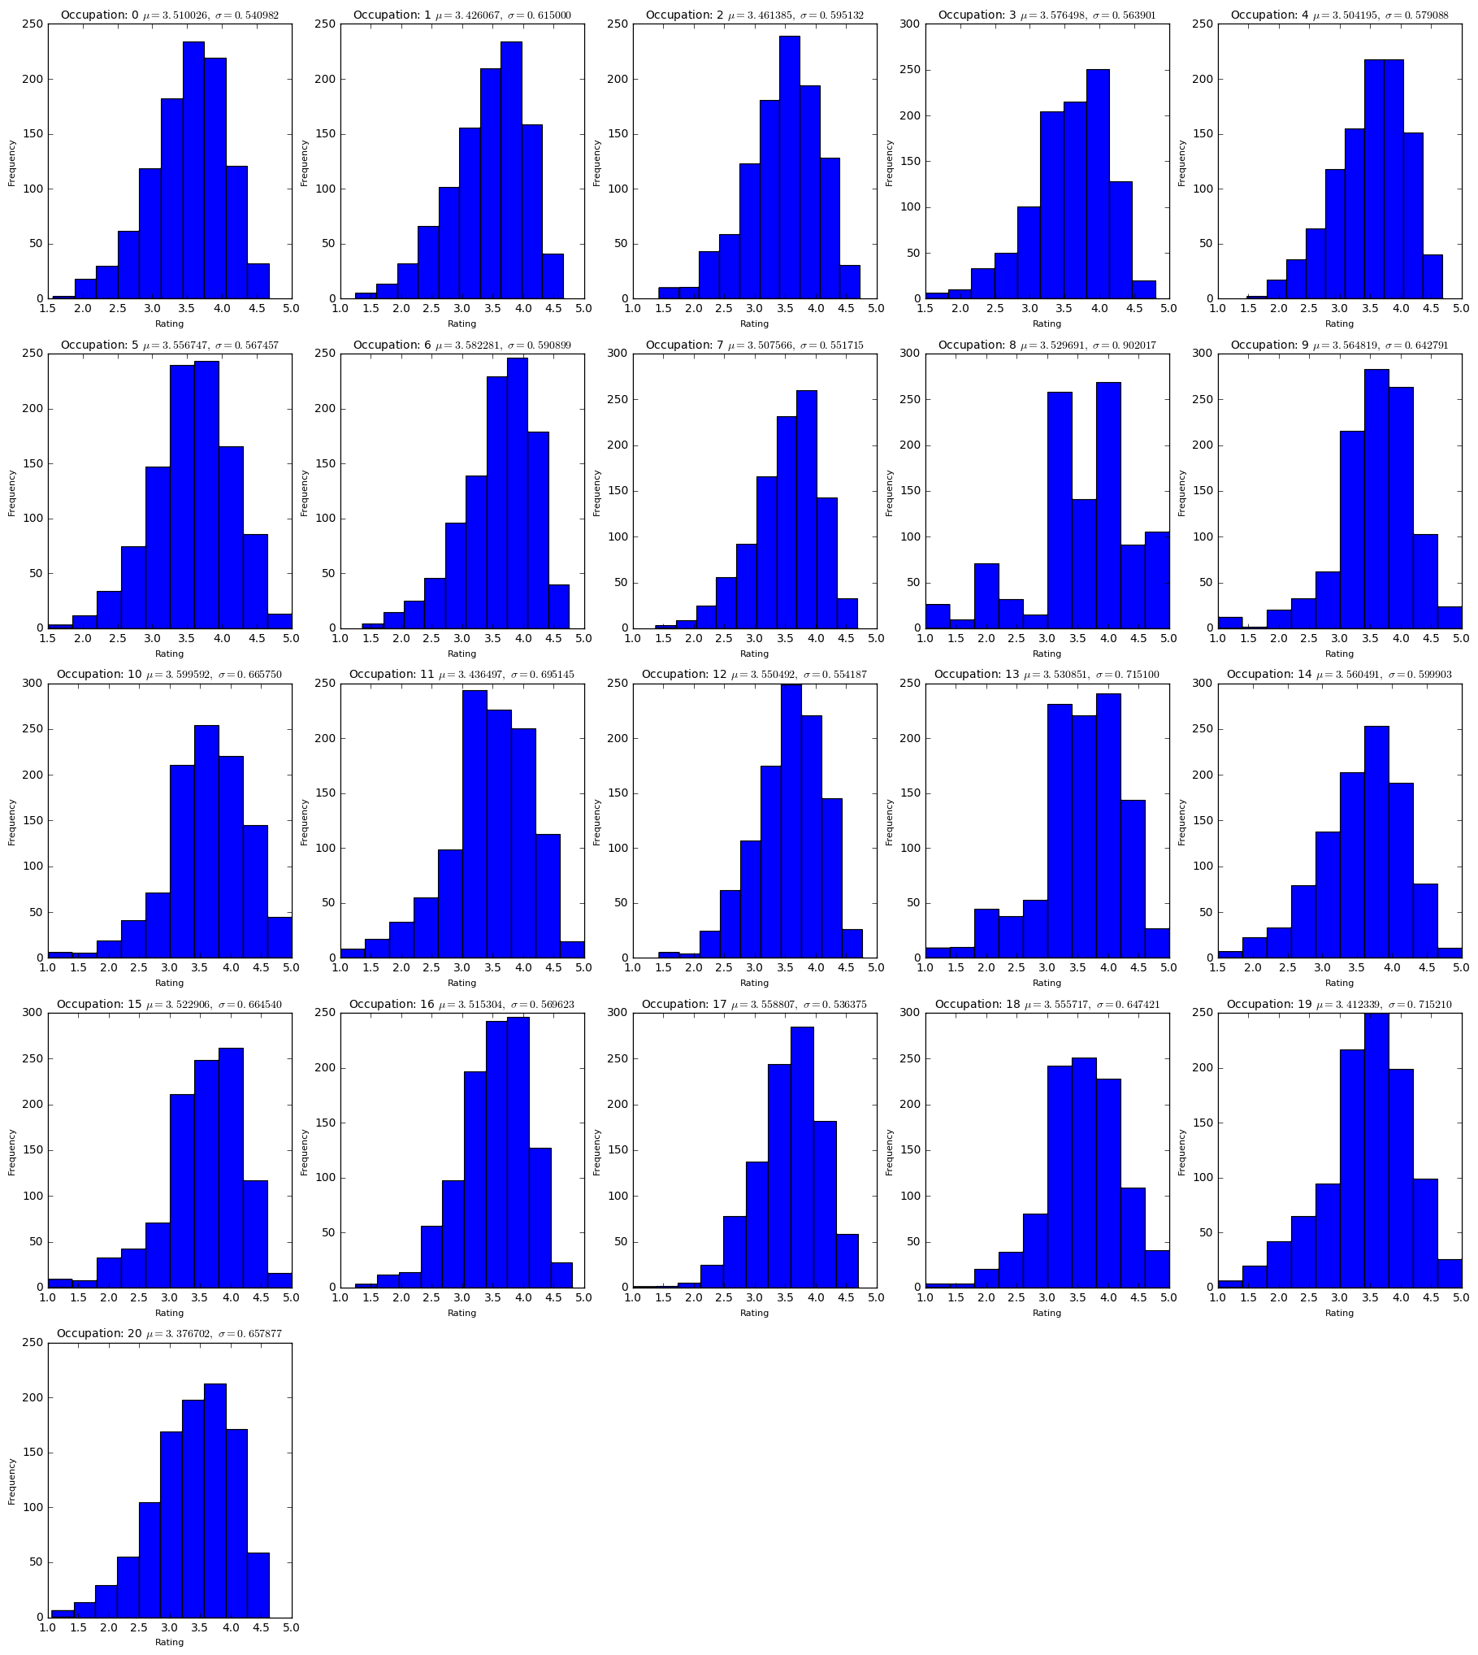

three
What did we find and conjecture in the data
#We conjecture that the others ratings distribution, occupation "8:farmer" have .
#Plot a histogram of the average rating for movies among different occupations

Slide 15
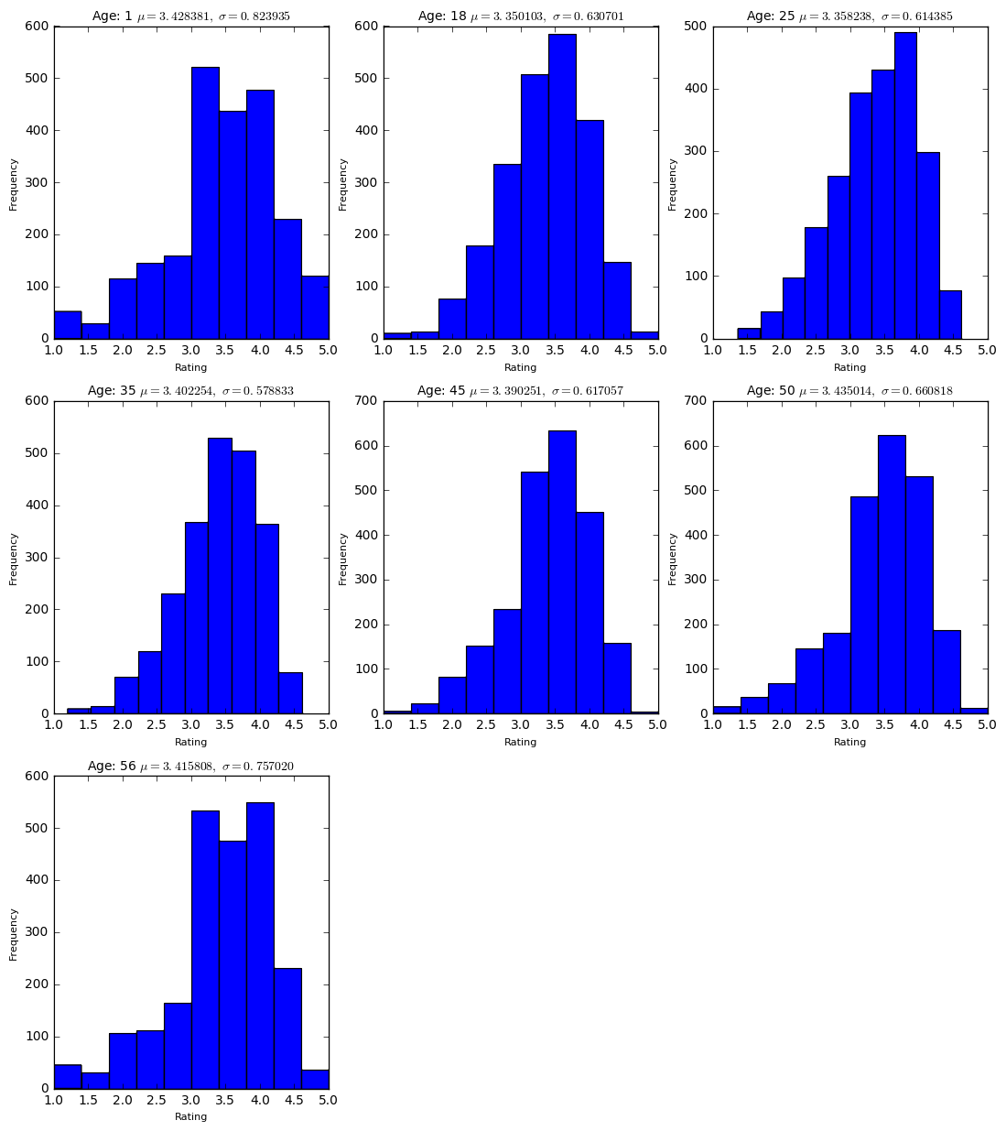
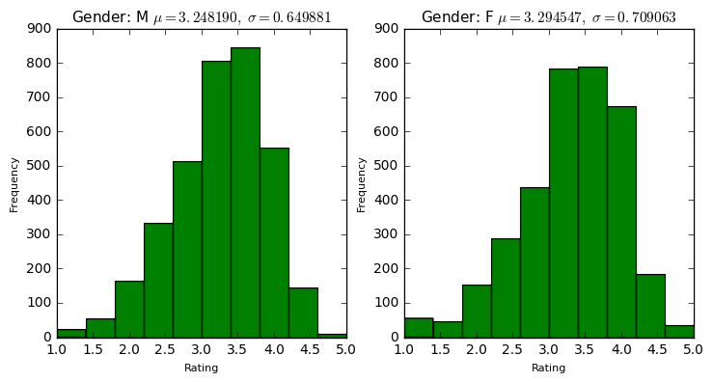
three
What did we find and conjecture in the data
#2. We conjecture that the women have more extreme ratings, and men's ratings distribution is more normal.
#Plot a histogram of the average rating for movies between men and women.
#3. We conjecture that the age range "1:Under 18", "56:56+" have more extreme ratings.
#Plot a histogram of the average rating for movies among different ages

Slide 16
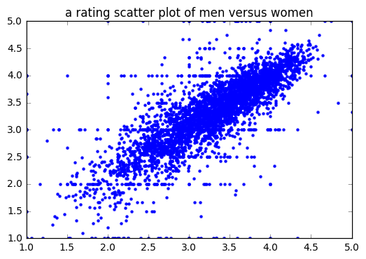

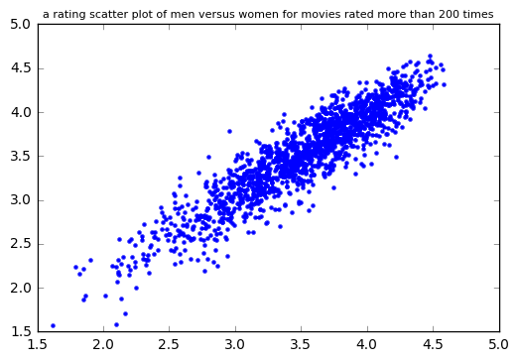
three
What did we find and conjecture in the data
#Make a scatter plot of men versus women and their mean rating for every movie.
#Make a scatter plot of men versus women and their mean rating for movies rated more than 200 times.
Notes:
#Observation:???#1. Male and Female are rating similiar,

Slide 17
three
What did we find and conjecture in the data
#Compute the correlation coefficient between the ratings of men and women.
76.319%
91.8361%
All Movies
Movies over 200 ratings
Correlation coefficient between the ratings of men and women
Notes:
#Observation:???#1. Male and Female are rating similiar,

Slide 18
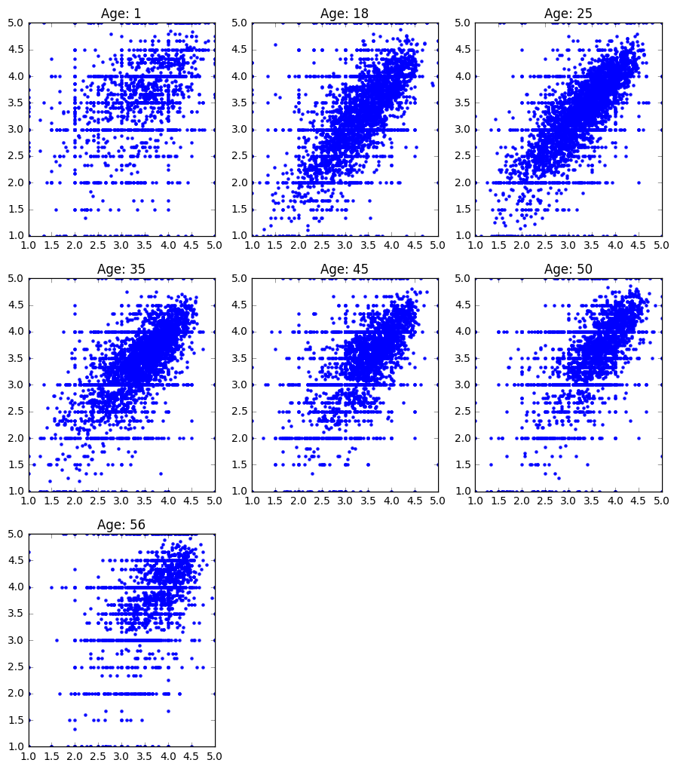
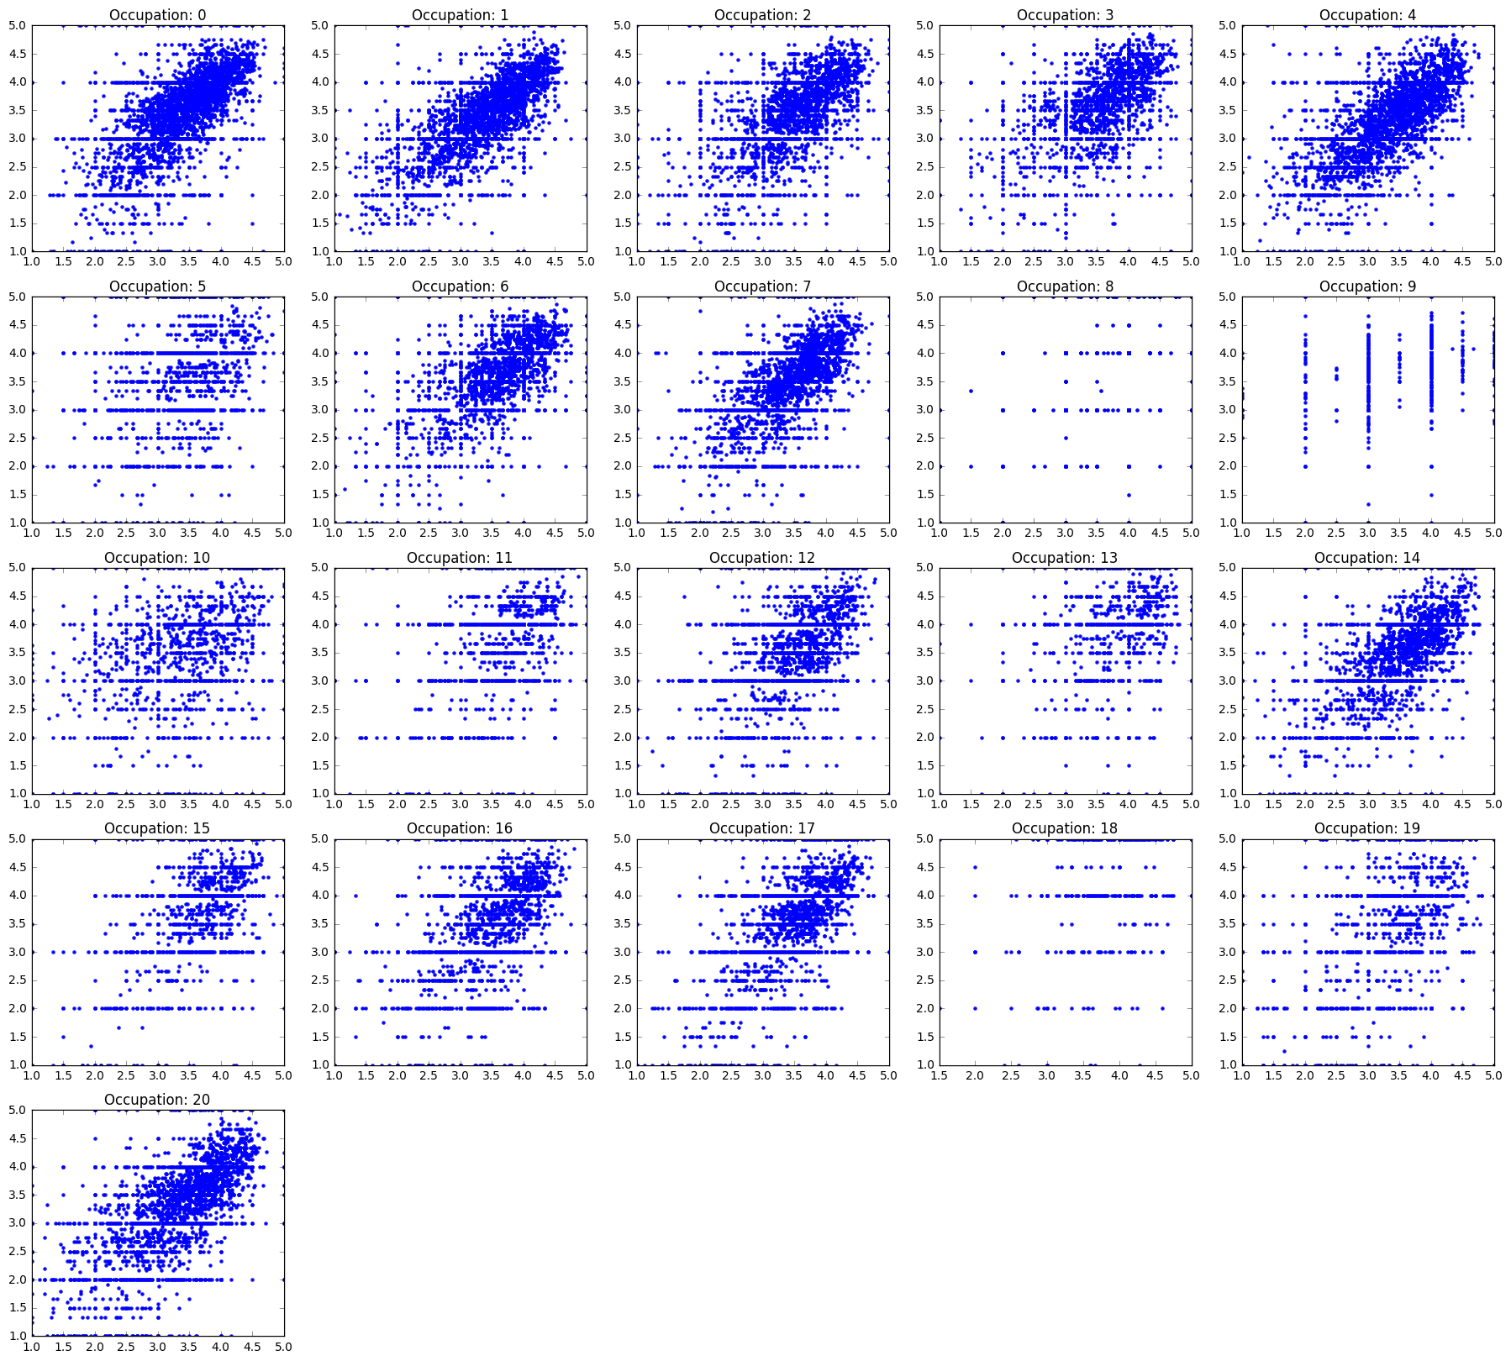
three
What did we find and conjecture in the data
#1. We conjecture that under the circumstance that "age between 25-34", we can predict the ratings by other gender.
#Compute the correlation coefficients between the ratings of men and women among different age groups.
#2. We conjecture that under the circumstance that "the occupation is academic/educator", we can predict the ratings by other gender.
#Compute the correlation coefficients between the ratings of men and women among different age groups.

Slide 19
four
Surprising data
Let’s go further

Slide 20
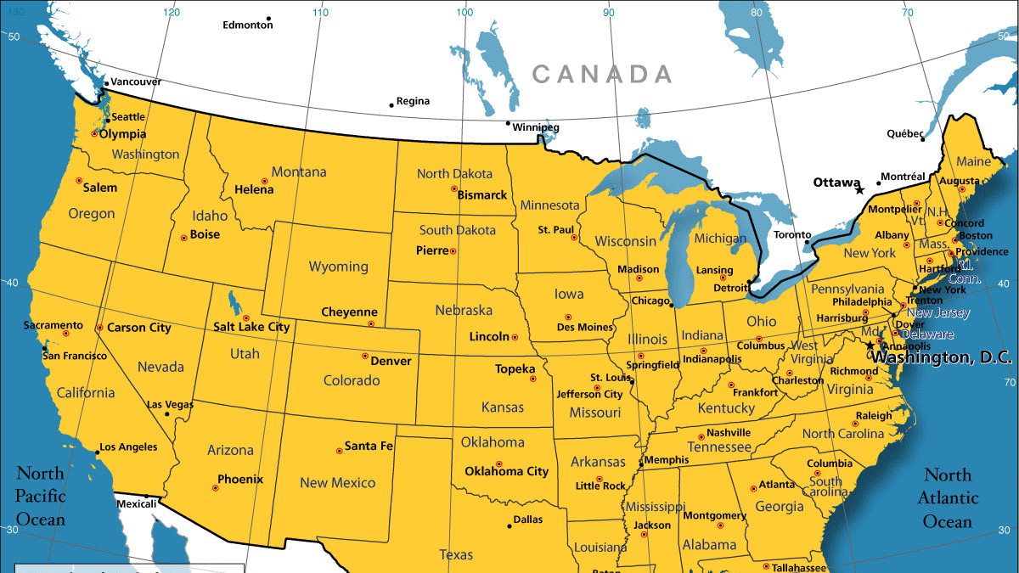
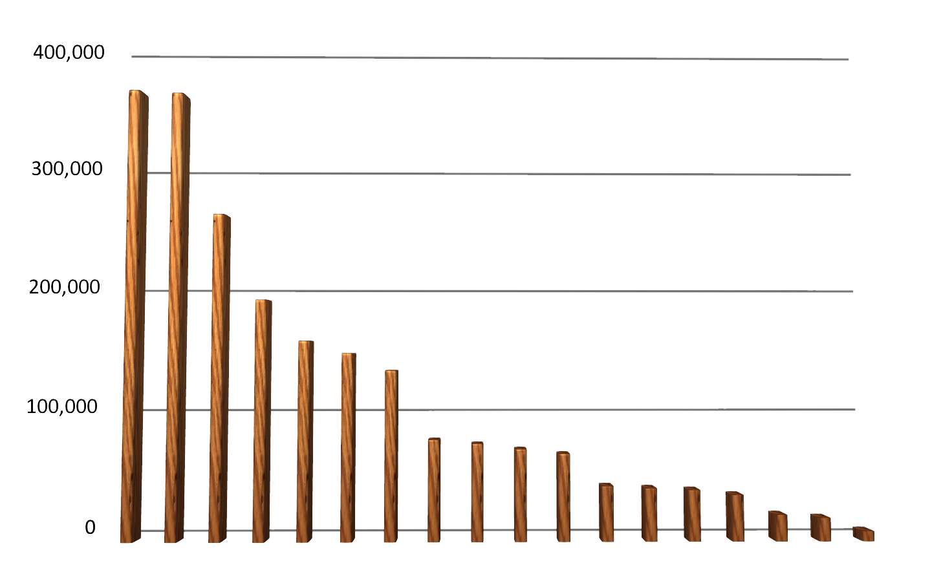
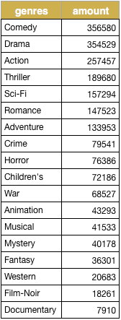

four
Surprising data
How about the genre?
Winner
Is
mine
Comedy
Drama
Action

Slide 21
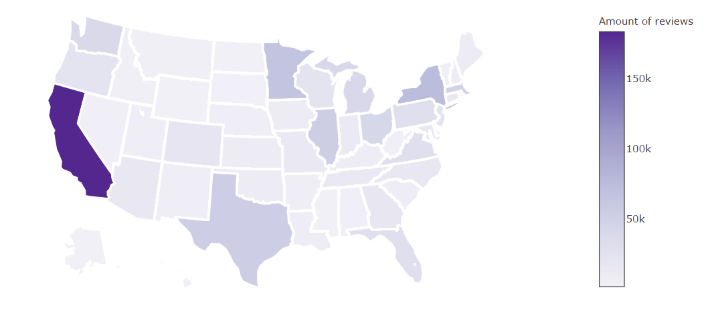
four
Surprising data
How about the every states?
Movies rate amount among different states
California

Slide 22
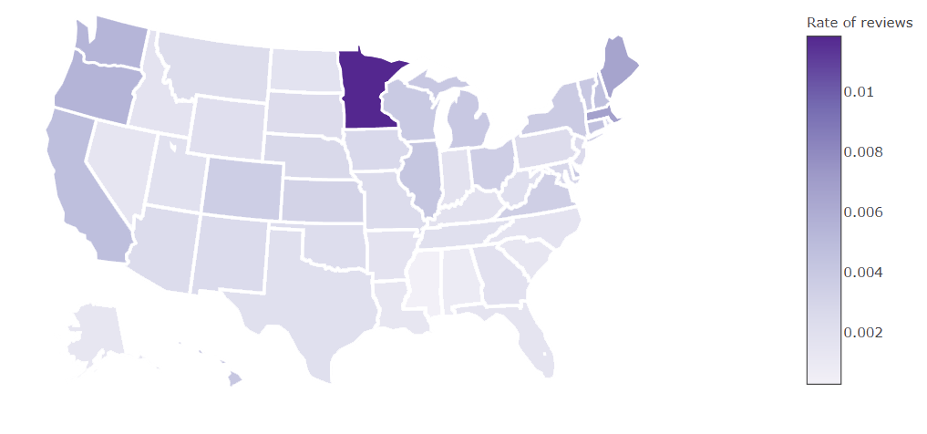
four
Surprising data
Movie Review Amount/Population among Different States
Minnesota

Slide 23
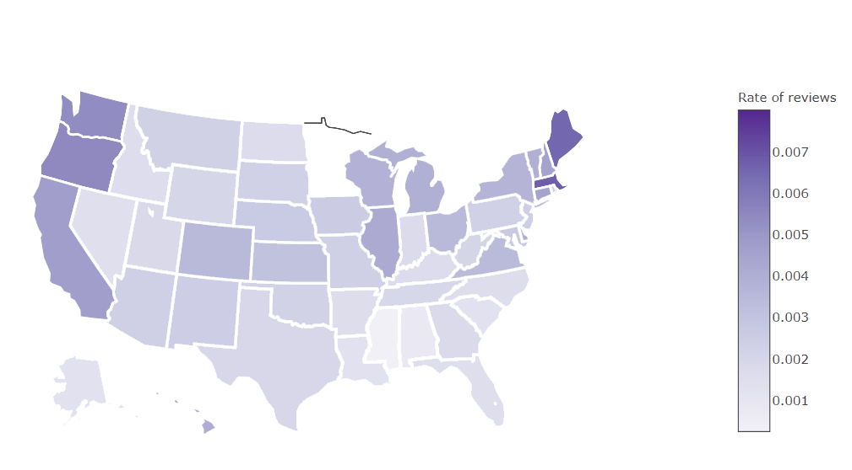
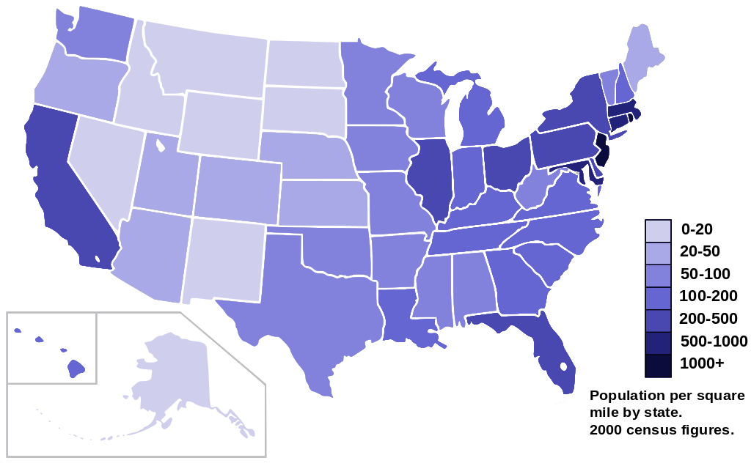
four
Surprising data
Movie Review Amount/Population among Different States
Texas
Texas
Florida
Florida

Slide 24
FIve
Conclusion
Conclusion
Occupation 17: technician/engineer
Age Range 25: 25-34
California
Florida & Taxes

Slide 25
SIX
citation
https://upload.wikimedia.org/wikipedia/commons/thumb/f/ff/US_2000_census_population_density_map_by_state.svg/1024px-US_2000_census_population_density_map_by_state.svg.png
https://thumbs.dreamstime.com/z/window-cleaner-washer-worker-shield-retro-illustration-cleaning-squeegee-viewed-rear-angle-set-inside-isolated-38820627.jpg
https://thumbs.dreamstime.com/x/i-love-you-hand-gesture-5702613.jpg
http://www.flaticon.com/free-icon/american-football_250581
https://movie.douban.com/subject_search?search_text=%E4%BE%8F%E7%BD%97%E7%BA%AA%E5%85%AC%E5%9B%AD&cat=1002
http://www.necouncilpta.com/pta/wp-content/uploads/2014/04/spotlightright.jpg

Slide 26
Thank You
谢谢
Notes:
Hello everyone, Hello professor Paffenroth, this is the second time we come here to share with you our found, ok, let’s start with this cover, there are 448 movie posters on screen, they are not the random, they are the movie I watched and rated in past 10 years. We do this for a little long time just want to make you guys love watching these slides.
*: I am a honest man, so I even use this poster twice to make this this happened.
You know, for some reason, it’s more easier to watch the movies around the world Hollywood, Bollywood and so on.

